Slide 1




Transparent in-situ Data Processing
Doctoral Project Plan
Tenth European Big Data Management & Analytics Summer School (eBISS 2022)
04/07/2022 - 08/07/2022
Cesena - Italy
ESR 2.1: Marcos N. L. Carvalho (UPC / ARC)
Home Advisors: Anna Queralt (UPC); Oscar Romero (UPC);
Host Advisor: Alkis Simitsis (ARC)

Slide 2

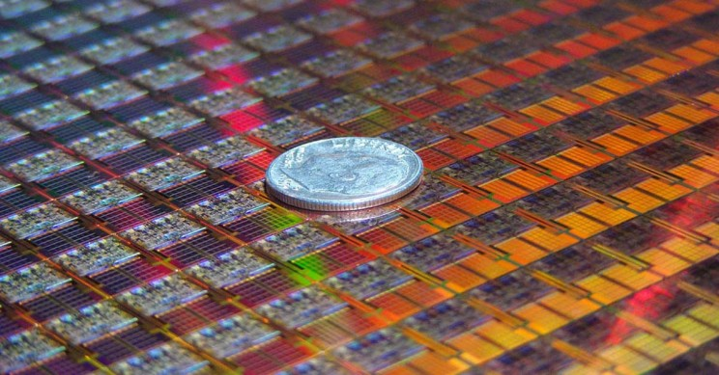
Motivation
To process large amounts of data quickly, data processing engines rely on advances in hardware architecture:
Physical limitations of enhancing microprocessors [9]:
Reducing transistor’s size (near the size of atoms) [31];
Increasing clock frequency (excessive heat dissipation) [6];
Trend: hardware is increasingly becoming heterogeneous [9]:
Integrating specialized processors (e.g., GPUs, FPGAs, etc) into computing systems, to match specific application demands;
Need of an ideal hardware-software to support data processing on such environments:
Place the right task on the right computing unit!
Source:Intel
Source:The Guardian

Slide 3
Motivation
What should be considered to place analytical tasks in different process units (CPU or GPU)?

Slide 4
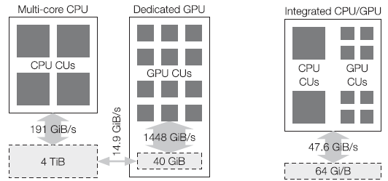
Motivation
Why processing data on heterogeneous CPU-GPU?
CPUs and GPUs are optimized for different usage scenarios [40]:
CPU: optimized for serial processing tasks (few complex cores);
GPU: optimized for parallel processing tasks (many simple cores):
Integrated GPU (iGPU): efficient communication / good for scheduling fine-grained tasks;
Dedicated GPU (dGPU): slow data transfers / good for scheduling coarse-grained tasks;
Source: Rosenfeld et al [40].

Slide 5
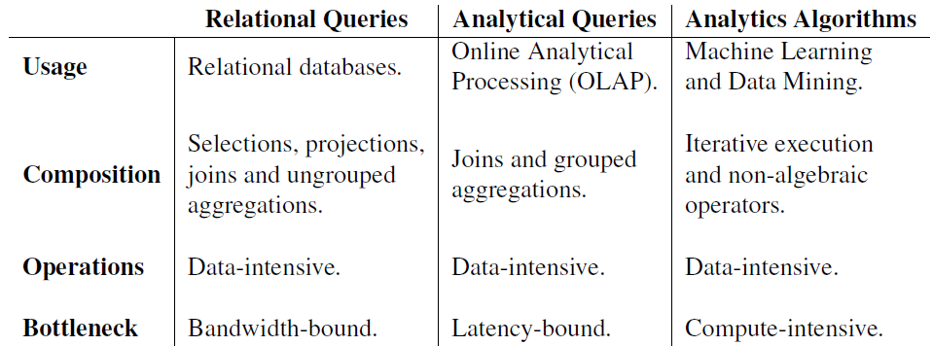
Motivation
Typical data processing and analytics systems:
These systems contain increasingly complex tasks that can be better executed in different processors (CPU or GPU).

Slide 6
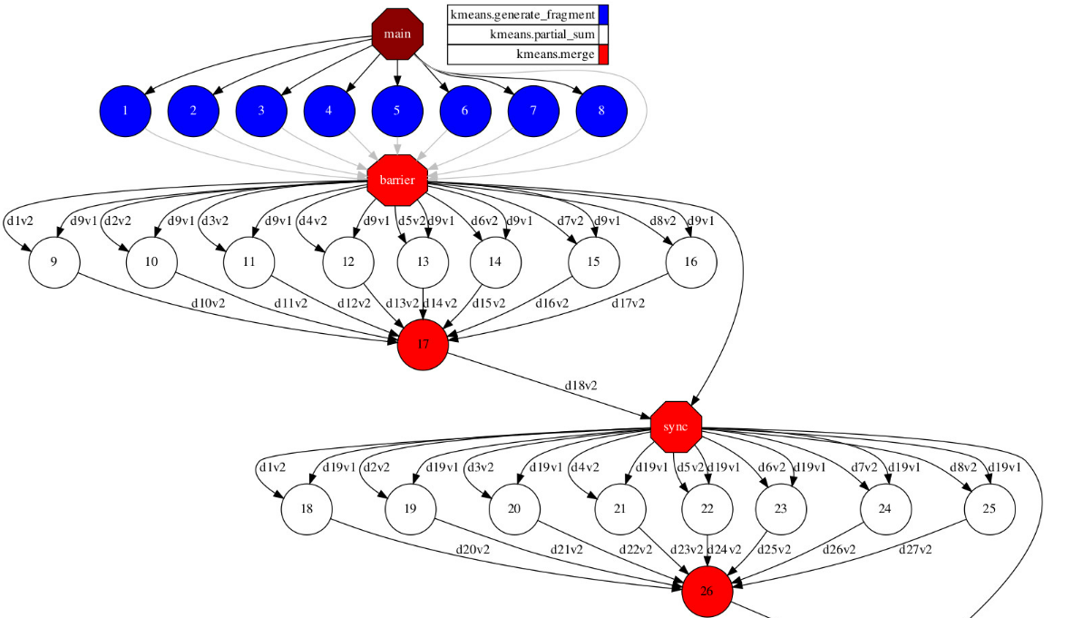


Motivation: Example
Typical representation of execution plans in data processing engines and database optimizers [14]:
Directed Acyclic Graph (DAG):
Nodes are tasks defined as units of work (e.g., a function, a method, a query operator, etc.);
Directed edges are dependencies between tasks.
Execution of Directed Acyclic Graphs (DAG)
on heterogeneous CPU-GPU environments:
Parallel execution of K-means:

Slide 7
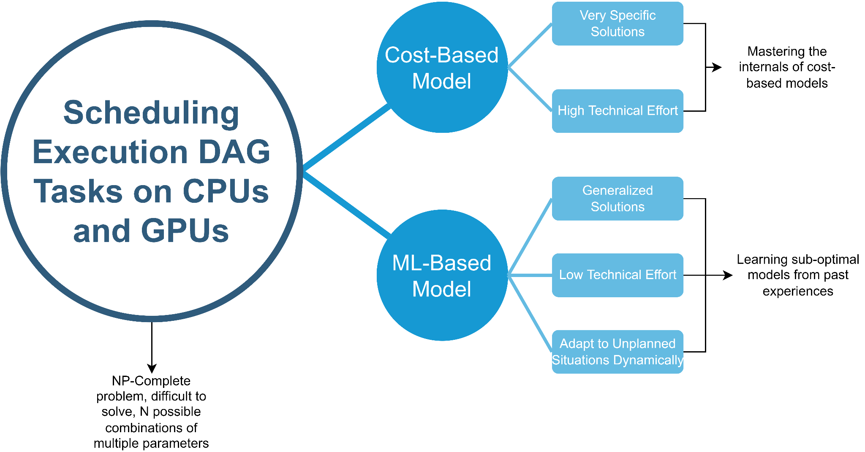
Motivation: Mapping the Problem

Slide 8
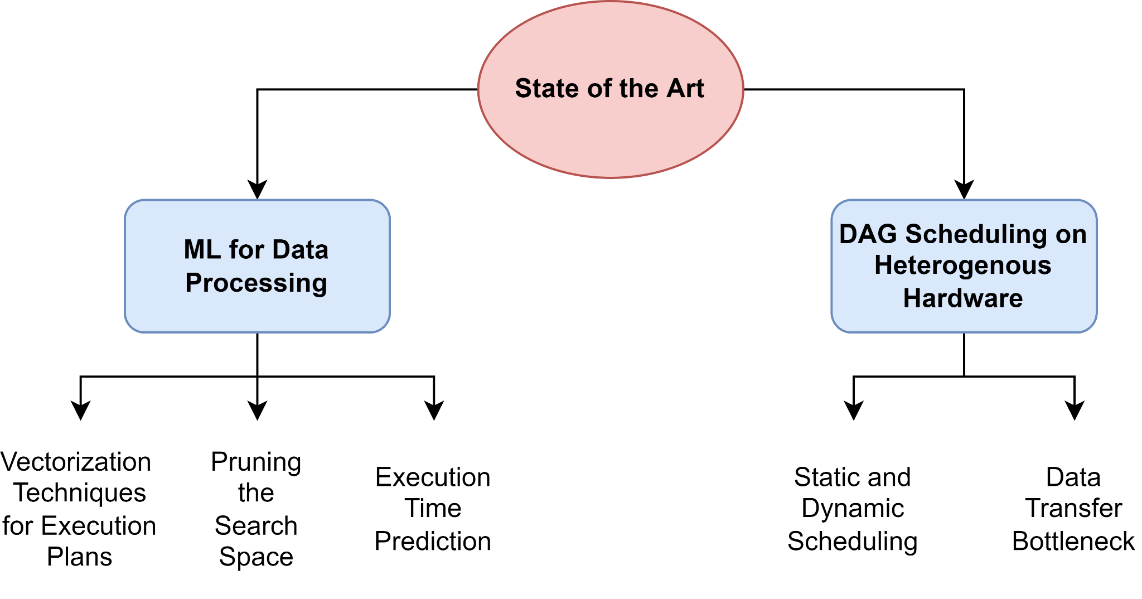
Related Work
Structure of the state of the art:
Throughput and memory limitations [16][27][39][40][43]
One-hot encoding of different level of the features: [20][18][28][14].
Cost-based heuristics [42][44][48] and ML-based approaches [14][53].
ML-based approaches: [20][18][28][55].
Advanced Neural networks: [35][19];

Slide 9
Summary
Gaps Identified:
There is no solution to automatically offload an analytical task to a GPU or CPU according to the system configuration and the current DAG;
Explore modern learning algorithms to improve the learning process:
Simple learning approaches are unable to scale to complex environments;
Novel approaches can improve generalization for transfer learning;
Lack of a multiobjective optimizer for task scheduling in CPUs and GPUs:
Minimizing execution time (most used in literature);
Minimizing energy consumption;
Maximizing throughput.
…
Lack of automatic solutions in any real-world data processing engine.

Slide 10
Research Question
Would it be possible to use learning techniques to dynamically predict the most appropriate hardware (in our case, CPU or GPU) to run each task in an execution DAG in a disaggregated architecture?

Slide 11
Project Objectives
Goal: to propose a novel adaptive learning optimizer to execute DAG tasks by balancing heterogeneous resources (CPU-GPU devices) in disaggregated architectures:
Given a data set and a DAG workflow, automatically predict the most appropriate processor (e.g., shortest execution time, lower power consumption, etc.) to execute each DAG task;
Integration of our adaptive optimizer in real data processing engines.
Objectives:
O1: Learning by doing and experiencing, with real settings of analytics how an heterogeneous system (CPU-GPU) behaves in a single node consisting of static resources (e.g., a fixed number of CPU and GPU cores);
O2: Develop a first version of the adaptive learning optimizer in a simplified setting (e.g., single node containing multiple CPU and GPU cores);
O3: Develop a second version of the adaptive learning optimizer in a disaggregated architecture in a scale-out setting (e.g., multiple nodes containing multiple CPU and GPU cores, interconnected by a fast network);
O4: A non-invasive solution that can easily integrate our adaptive learning optimizer to any data processing engine.

Slide 12
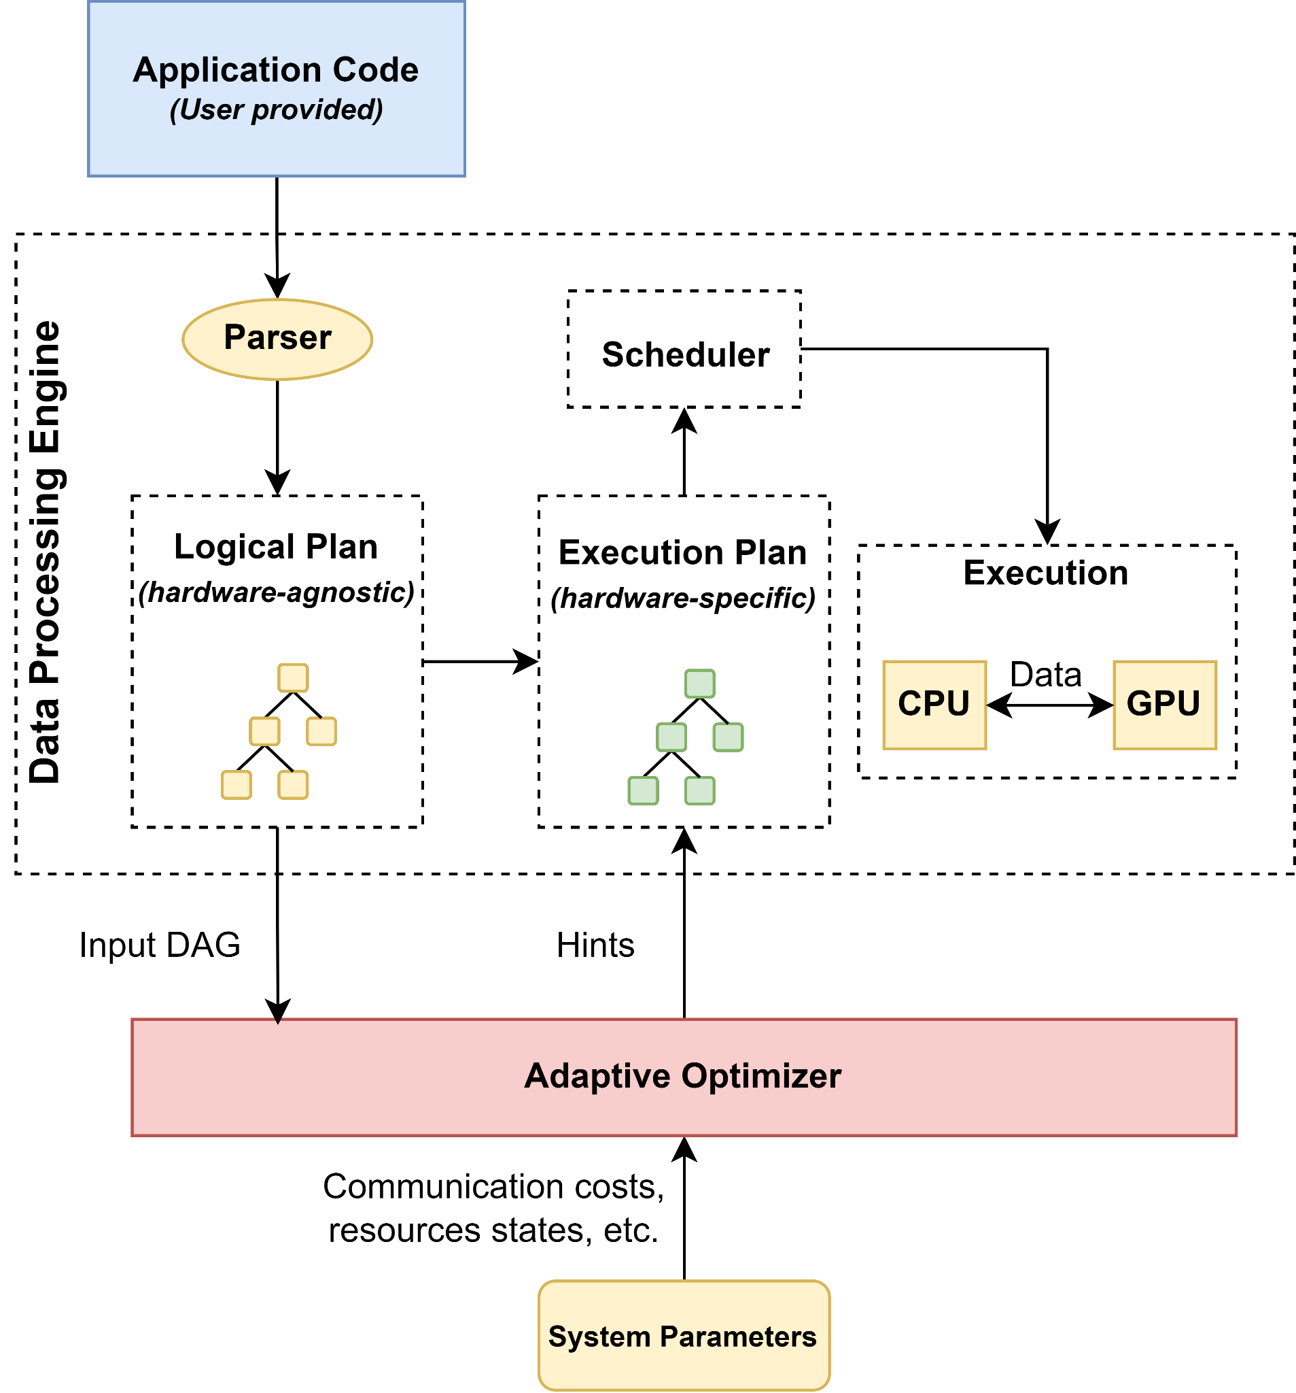
Project Objectives
Tentative system model architecture:

Slide 13

Project Objectives
Tentative system model architecture:

Slide 14
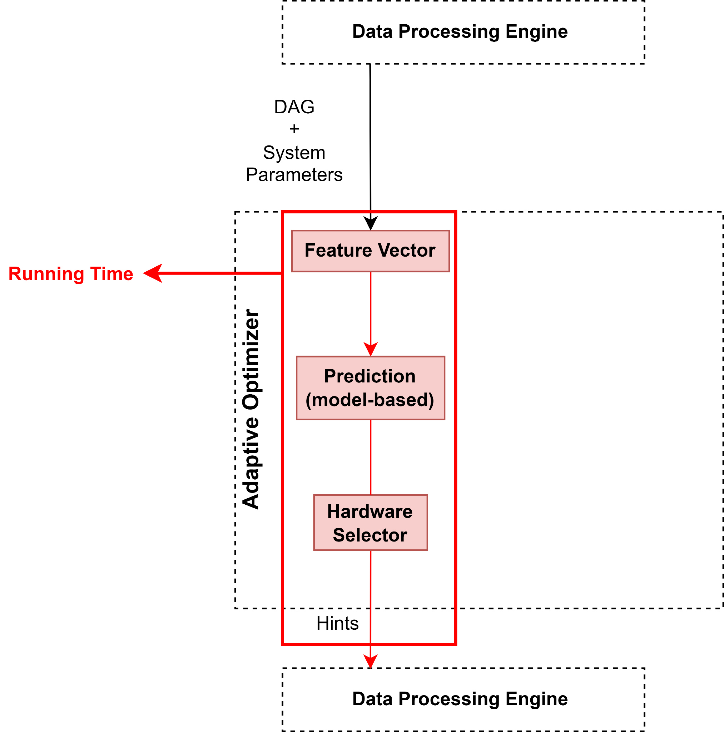
Project Objectives
Tentative workflow for the adaptive algorithm:
Running time: Once the model is trained, a given DAG and system parameters are vectorized.
1

Slide 15
Project Objectives
Tentative workflow for the adaptive algorithm:
Running time: Predictions about the cost (e.g., complete DAG execution time, energy consumption, etc.) of each CPU-GPU configuration are generated.
2

Slide 16
Project Objectives
Tentative workflow for the adaptive algorithm:
Running time: The hardware selector chooses the best CPU-GPU configuration in terms of cost predictions to build a draft of the best execution plan (for each task in the DAG). This information is sent as hints to the data processing engine.
3

Slide 17
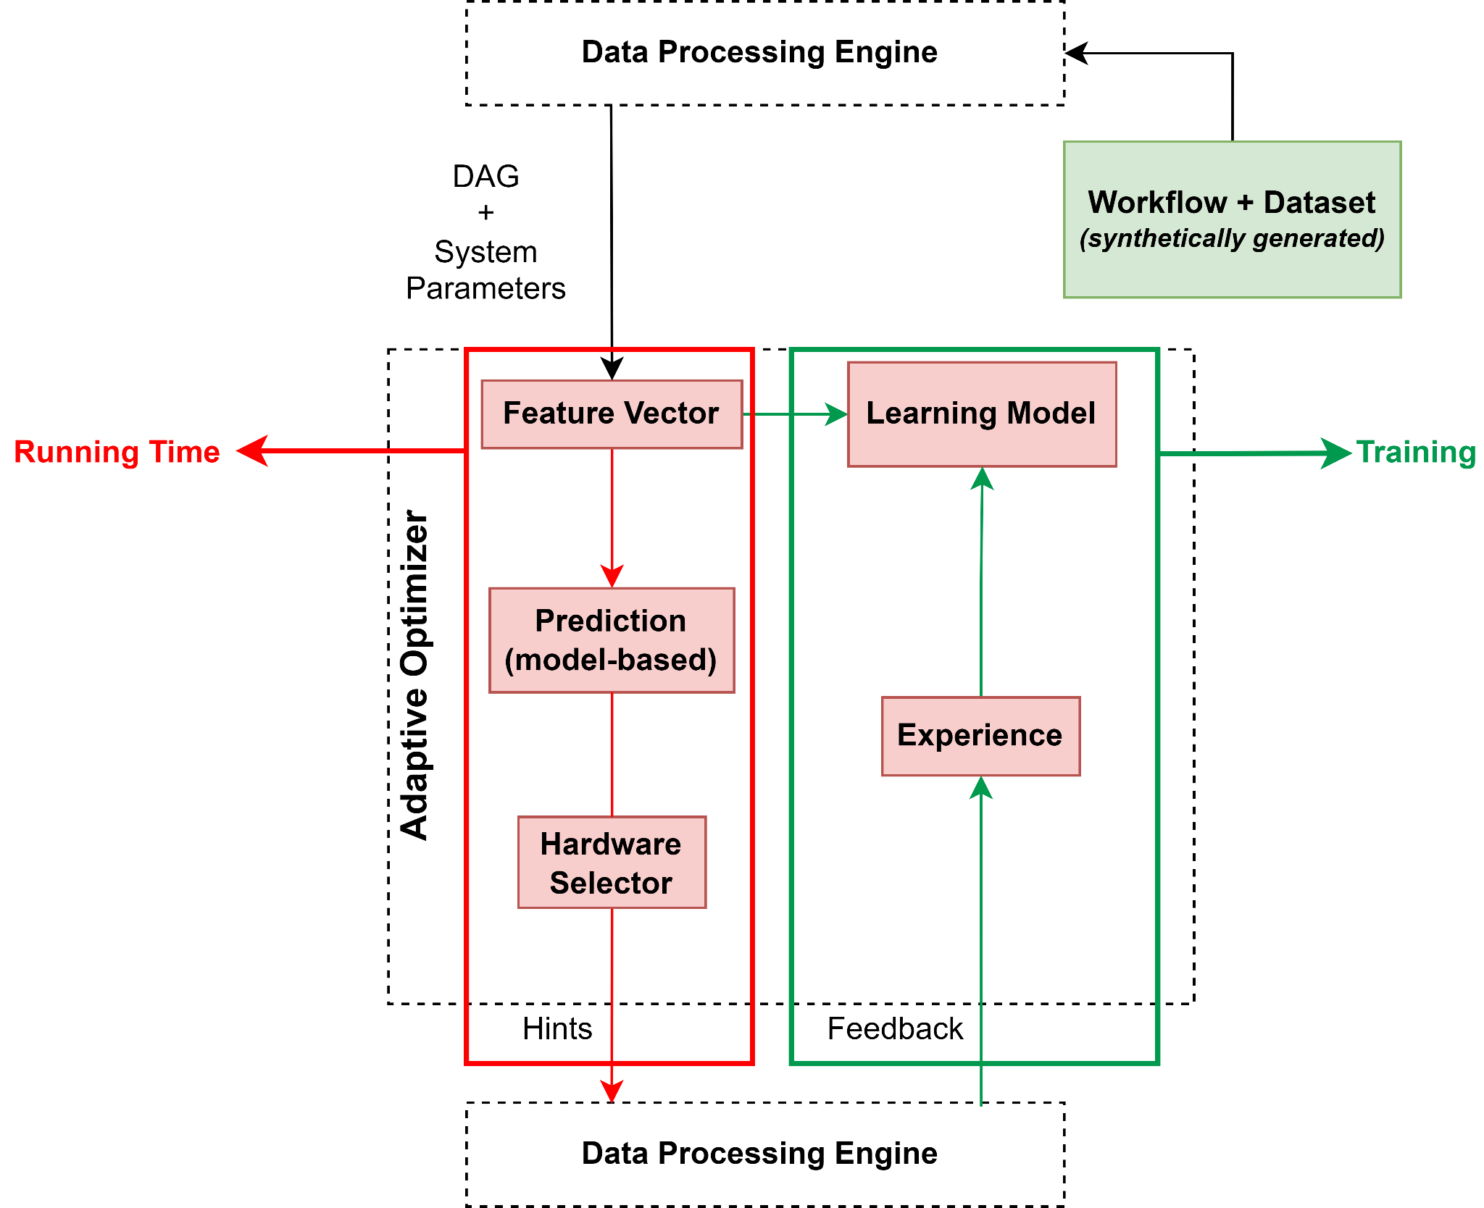
Project Objectives
Tentative workflow for the adaptive algorithm:
Training: A set of DAG and system parameters are vectorized and used as input for the learning model.
1

Slide 18
Project Objectives
Tentative workflow for the adaptive algorithm:
Training: Feedback gathered from the proposed hints.
2

Slide 19
Project Objectives
Tentative workflow for the adaptive algorithm:
Training: Update the model considering the training testbed and the experience.
3

Slide 20
Significance and Outcome
Improving the overall efficiency of data processing engines in complex scenarios without requiring advanced knowledge of the internals of cost-based heuristics approaches;
Automate device offloading for developers;
Transparency to the user;
No need to be expert in heterogeneous programming;
Saving time profiling algorithms.
Efficient use of available resources:
Optimize execution time, energy consumption throughput, etc.
Alleviate the deployment of an adaptive optimizer in real-world data processing engines through the integration of our solution into the main engines;
Scheduling DAG tasks on heterogeneous CPU-GPU processors is an active topic for both industry and scientific community and improvements in this area can enable the development of further applications related to Big Data.

Slide 21
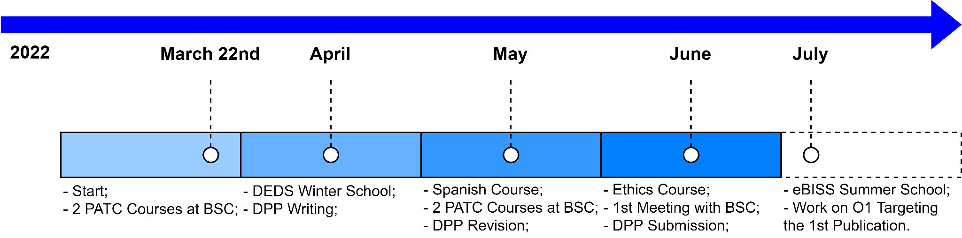
Project Timeline and Current Status

Slide 22

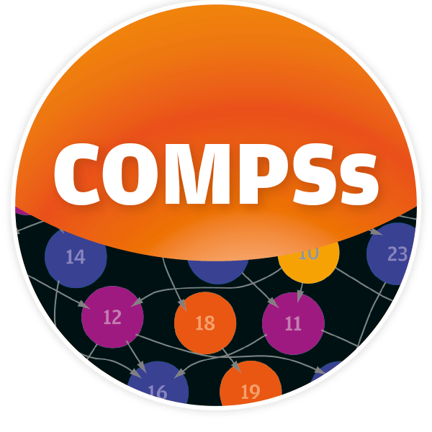

Meeting O1 Requirements
Work on O1 targeting the first publication:
How? Create an exhaustive benchmark testing analytical tasks with different parameters and learn the main effects they have (extract relevant features for the learned model).
BSC Support:
BSC software:
Data processing engine: COMPSs [4];
Algorithms: dislib [59]:
Distributed algorithms focused on machine learning, inspired by scikit-learn.
BSC infrastructure:
Supercomputer with heterogeneous hardware suitable for experiments on High Performance Computing systems;
BSC support:
Support of advanced developers and experts for eventual questions and issues with the hardware and software.

Slide 23
References
[1] Daniel Abadi, Anastasia Ailamaki, David Andersen, Peter Bailis, Magdalena Balazinska, Philip Bernstein, Peter Boncz, Surajit Chaudhuri, Alvin Cheung, AnHai Doan, et al. The seattle report on database research. ACM SIGMOD Record, 48(4):44–53, 2020.
[2] Ishfaq Ahmad and Yu-Kwong Kwok. On exploiting task duplication in parallel program scheduling. IEEE Transactions on parallel and distributed systems, 9(9):872–892, 1998.
[3] Hamid Arabnejad and Jorge G Barbosa. List scheduling algorithm for heterogeneous systems by an optimistic cost table. IEEE Transactions on Parallel and Distributed Systems, 25(3):682–694, 2013.
[4] Rosa M Badia, Javier Conejero, Carlos Diaz, Jorge Ejarque, Daniele Lezzi, Francesc Lordan, Cristian Ramon-Cortes, and Raul Sirvent. Comp superscalar, an interoperable programming framework. SoftwareX, 3:32–36, 2015.
[5] Tal Ben-Nun, Maciej Besta, Simon Huber, Alexandros Nikolaos Ziogas, Daniel Peter, and Torsten Hoefler. A modular benchmarking infrastructure for high-performance and reproducible deep learning. In 2019 IEEE International Parallel and Distributed Processing Symposium (IPDPS), pages 66–77. IEEE, 2019.
[6] Mark Bohr. A 30 year retrospective on dennard’s mosfet scaling paper. IEEE Solid-State Circuits Society Newsletter, 12(1):11–13, 2007.
[7] Shekhar Borkar and Andrew A Chien. The future of microprocessors. Communications of the ACM, 54(5):67–77, 2011.
[8] George Bosilca, Aurelien Bouteiller, Anthony Danalis, Thomas Herault, Pierre Lemarinier, and Jack Dongarra. Dague: A generic distributed dag engine for high performance computing. Parallel Computing, 38(1-2):37–51, 2012.
[9] George Bosilca, Aurelien Bouteiller, Anthony Danalis, Thomas Herault, Pitior Luszczek, and Jack Dongarra. Dense linear algebra on distributed heterogeneous hardware with a symbolic dag approach. Technical report, Lawrence Berkeley National Lab.(LBNL), Berkeley, CA (United States), 2012.
[10] Sebastian Breß, Felix Beier, Hannes Rauhe, Kai-Uwe Sattler, Eike Schallehn, and Gunter Saake. Efficient co-processor utilization in database query processing. Information Systems, 38(8):1084– 1096, 2013.
[11] Jian Fang, Yvo TB Mulder, Jan Hidders, Jinho Lee, and H Peter Hofstee. In-memory database acceleration on fpgas: a survey. The VLDB Journal, 29(1):33–59, 2020.
[12] Archana Ganapathi, Harumi Kuno, Umeshwar Dayal, Janet L Wiener, Armando Fox, Michael Jordan, and David Patterson. Predicting multiple metrics for queries: Better decisions enabled by machine learning. In 2009 IEEE 25th International Conference on Data Engineering, pages 592– 603. IEEE, 2009.
[13] Justin Gottschlich, Armando Solar-Lezama, Nesime Tatbul, Michael Carbin, Martin Rinard, Regina Barzilay, Saman Amarasinghe, Joshua B Tenenbaum, and Tim Mattson. The three pillars of machine programming. In Proceedings of the 2nd ACM SIGPLAN International Workshop on Machine Learning and Programming Languages, pages 69–80, 2018.
[14] Nathan Grinsztajn, Olivier Beaumont, Emmanuel Jeannot, and Philippe Preux. Readys: A reinforcement learning based strategy for heterogeneous dynamic scheduling. In 2021 IEEE International Conference on Cluster Computing (CLUSTER), pages 70–81. IEEE, 2021.
[15] Yuxing Han, Ziniu Wu, Peizhi Wu, Rong Zhu, Jingyi Yang, Liang Wei Tan, Kai Zeng, Gao Cong, Yanzhao Qin, Andreas Pfadler, et al. Cardinality estimation in dbms: A comprehensive benchmark evaluation. arXiv preprint arXiv:2109.05877, 2021.
[16] Zahaf Houssam-Eddine, Nicola Capodieci, Roberto Cavicchioli, Giuseppe Lipari, and Marko Bertogna. The hpc-dag task model for heterogeneous real-time systems. IEEE Transactions on Computers, 70(10):1747–1761, 2020.
[17] Hidehiro Kanemitsu, Masaki Hanada, and Hidenori Nakazato. Clustering-based task scheduling in a large number of heterogeneous processors. IEEE Transactions on Parallel and Distributed Systems, 27(11):3144–3157, 2016.
[18] Zoi Kaoudi, Jorge-Arnulfo Quiane-Ruiz, Bertty Contreras-Rojas, Rodrigo Pardo-Meza, Anis ´ Troudi, and Sanjay Chawla. Ml-based cross-platform query optimization. In 2020 IEEE 36th International Conference on Data Engineering (ICDE), pages 1489–1500. IEEE, 2020.
[19] Thomas N Kipf and Max Welling. Semi-supervised classification with graph convolutional networks. arXiv preprint arXiv:1609.02907, 2016.
[20] Sanjay Krishnan, Zongheng Yang, Ken Goldberg, Joseph Hellerstein, and Ion Stoica. Learning to optimize join queries with deep reinforcement learning. arXiv preprint arXiv:1808.03196, 2018.
[21] Patrick Kurp. Green computing. Communications of the ACM, 51(10):11–13, 2008.
[22] Yu-Kwong Kwok and Ishfaq Ahmad. Static scheduling algorithms for allocating directed task graphs to multiprocessors. ACM Computing Surveys (CSUR), 31(4):406–471, 1999.

Slide 24
References
[23] Suyeon Lee and Sungyong Park. Performance analysis of big data etl process over cpu-gpu heterogeneous architectures. In 2021 IEEE 37th International Conference on Data Engineering Workshops (ICDEW), pages 42–47. IEEE, 2021.
[24] Viktor Leis, Andrey Gubichev, Atanas Mirchev, Peter Boncz, Alfons Kemper, and Thomas Neumann. How good are query optimizers, really? Proceedings of the VLDB Endowment, 9(3):204– 215, 2015.
[25] Guoliang Li, Xuanhe Zhou, and Lei Cao. Machine learning for databases. In The First International Conference on AI-ML-Systems, pages 1–2, 2021.
[26] Guoliang Li, Xuanhe Zhou, Shifu Li, and Bo Gao. Qtune: A query-aware database tuning system with deep reinforcement learning. Proceedings of the VLDB Endowment, 12(12):2118–2130, 2019.
[27] Clemens Lutz, Sebastian Breß, Steffen Zeuch, Tilmann Rabl, and Volker Markl. Pump up the volume: Processing large data on gpus with fast interconnects. In Proceedings of the 2020 ACM SIGMOD International Conference on Management of Data, pages 1633–1649, 2020.
[28] Ryan Marcus, Parimarjan Negi, Hongzi Mao, Nesime Tatbul, Mohammad Alizadeh, and Tim Kraska. Bao: Making learned query optimization practical. In Proceedings of the 2021 International Conference on Management of Data, pages 1275–1288, 2021.
[29] Ryan Marcus, Parimarjan Negi, Hongzi Mao, Chi Zhang, Mohammad Alizadeh, Tim Kraska, Olga Papaemmanouil, and Nesime Tatbul. Neo: A learned query optimizer. arXiv preprint arXiv:1904.03711, 2019.
[30] Ryan Marcus and Olga Papaemmanouil. Plan-structured deep neural network models for query performance prediction. arXiv preprint arXiv:1902.00132, 2019.
[31] Jesus Mart ´ ´ınez-Blanco, Christophe Nacci, Steven C Erwin, Kiyoshi Kanisawa, Elina Locane, Mark Thomas, Felix Von Oppen, Piet W Brouwer, and Stefan Folsch. Gating a single-molecule transistor ¨ with individual atoms. Nature Physics, 11(8):640–644, 2015.
[32] Peter Mattson, Christine Cheng, Gregory Diamos, Cody Coleman, Paulius Micikevicius, David Patterson, Hanlin Tang, Gu-Yeon Wei, Peter Bailis, Victor Bittorf, et al. Mlperf training benchmark. Proceedings of Machine Learning and Systems, 2:336–349, 2020.
[33] Ruben Mayer, Christian Mayer, and Larissa Laich. The tensorflow partitioning and scheduling problem: it’s the critical path! In Proceedings of the 1st Workshop on Distributed Infrastructures for Deep Learning, pages 1–6, 2017.
[34] Azalia Mirhoseini, Hieu Pham, Quoc V Le, Benoit Steiner, Rasmus Larsen, Yuefeng Zhou, Naveen Kumar, Mohammad Norouzi, Samy Bengio, and Jeff Dean. Device placement optimization with reinforcement learning. In International Conference on Machine Learning, pages 2430–2439. PMLR, 2017.
[35] Lili Mou, Ge Li, Lu Zhang, Tao Wang, and Zhi Jin. Convolutional neural networks over tree structures for programming language processing. In Thirtieth AAAI conference on artificial intelligence, 2016.
[36] Sara Mustafa, Iman Elghandour, and Mohamed A Ismail. A machine learning approach for predicting execution time of spark jobs. Alexandria engineering journal, 57(4):3767–3778, 2018.
[37] Thomas Neumann and Guido Moerkotte. Generating optimal dag-structured query evaluation plans. Computer Science-Research and Development, 24(3):103–117, 2009.
[38] Cristian Ramon-Cortes, Pol Alvarez, Francesc Lordan, Javier Alvarez, Jorge Ejarque, and Rosa M Badia. A survey on the distributed computing stack. Computer Science Review, 42:100422, 2021.
[39] Syed Mohammad Aunn Raza, Periklis Chrysogelos, Panagiotis Sioulas, Vladimir Indjic, Angelos Christos Anadiotis, and Anastasia Ailamaki. Gpu-accelerated data management under the test of time. In Online proceedings of the 10th Conference on Innovative Data Systems Research (CIDR), number CONF, 2020.
[40] Viktor Rosenfeld, Sebastian Breß, and Volker Markl. Query processing on heterogeneous cpu/gpu systems. ACM Computing Surveys (CSUR), 55(1):1–38, 2022.
[41] Stuart Russell and Peter Norvig. Artificial intelligence: a modern approach. 2002.
[42] Rizos Sakellariou and Henan Zhao. A hybrid heuristic for dag scheduling on heterogeneous systems. In 18th International Parallel and Distributed Processing Symposium, 2004. Proceedings., page 111. IEEE, 2004.
[43] Anil Shanbhag, Samuel Madden, and Xiangyao Yu. A study of the fundamental performance characteristics of gpus and cpus for database analytics. In Proceedings of the 2020 ACM SIGMOD international conference on Management of data, pages 1617–1632, 2020.
[44] Gilbert C Sih and Edward A Lee. A compile-time scheduling heuristic for interconnectionconstrained heterogeneous processor architectures. IEEE transactions on Parallel and Distributed systems, 4(2):175–187, 1993.

Slide 25
References
[45] Poonam Singh, Maitreyee Dutta, and Naveen Aggarwal. A review of task scheduling based on meta-heuristics approach in cloud computing. Knowledge and Information Systems, 52(1):1–51, 2017.
[46] Fuhong Song, Huanlai Xing, Xinhan Wang, Shouxi Luo, Penglin Dai, and Ke Li. Offloading dependent tasks in multi-access edge computing: A multi-objective reinforcement learning approach. Future Generation Computer Systems, 128:333–348, 2022.
[47] Richard S Sutton and Andrew G Barto. Reinforcement learning: An introduction. MIT press, 2018.
[48] Haluk Topcuoglu, Salim Hariri, and Min-You Wu. Performance-effective and low-complexity task scheduling for heterogeneous computing. IEEE transactions on parallel and distributed systems, 13(3):260–274, 2002.
[49] Transaction Processing Performance Council (TPC). Tpc-h vesion 2 and version 3. https:// www.tpc.org/tpch/. Accessed: April 2022.
[50] Dimitris Tsesmelis and Alkis Simitsis. Database optimizers in the era of learning. In 2022 IEEE 37th International Conference on Data Engineering (ICDE). IEEE, 2022.
[51] Shivaram Venkataraman, Zongheng Yang, Michael Franklin, Benjamin Recht, and Ion Stoica. Ernest: Efficient performance prediction for {Large-Scale} advanced analytics. In 13th USENIX Symposium on Networked Systems Design and Implementation (NSDI 16), pages 363–378, 2016.
[52] Xiaoying Wang, Changbo Qu, Weiyuan Wu, Jiannan Wang, and Qingqing Zhou. Are we ready for learned cardinality estimation? arXiv preprint arXiv:2012.06743, 2020.
[53] Qing Wu, Zhiwei Wu, Yuehui Zhuang, and Yuxia Cheng. Adaptive dag tasks scheduling with deep reinforcement learning. In International Conference on Algorithms and Architectures for Parallel Processing, pages 477–490. Springer, 2018.
[54] Yuming Xu, Kenli Li, Jingtong Hu, and Keqin Li. A genetic algorithm for task scheduling on heterogeneous computing systems using multiple priority queues. Information Sciences, 270:255– 287, 2014.
[55] Zongheng Yang, Wei-Lin Chiang, Sifei Luan, Gautam Mittal, Michael Luo, and Ion Stoica. Balsa: Learning a query optimizer without expert demonstrations. arXiv preprint arXiv:2201.01441, 2022.
[56] Matei Zaharia, Mosharaf Chowdhury, Tathagata Das, Ankur Dave, Justin Ma, Murphy McCauly, Michael J Franklin, Scott Shenker, and Ion Stoica. Resilient distributed datasets: A {Fault-Tolerant} abstraction for {In-Memory} cluster computing. In 9th USENIX Symposium on Networked Systems Design and Implementation (NSDI 12), pages 15–28, 2012.
[57] Shuhao Zhang, Feng Zhang, Yingjun Wu, Bingsheng He, and Paul Johns. Hardware-conscious stream processing: A survey. ACM SIGMOD Record, 48(4):18–29, 2020.
[58] Wei Zhang, Wei Wei, Lingjie Xu, Lingling Jin, and Cheng Li. Ai matrix: A deep learning benchmark for alibaba data centers. arXiv preprint arXiv:1909.10562, 2019.
[59] Javier Alvarez Cid-Fuentes, Salvi Sol ´ a, Pol ` Alvarez, Alfred Castro-Ginard, and Rosa M. Badia. ´ dislib: Large Scale High Performance Machine Learning in Python. In Proceedings of the 15th International Conference on eScience, pages 96–105, 2019.

